Slide 1

DATA 400: CAPSTONE IN DATA ANALYTICS
PHAM DUY ANH VU
NBA BETTING ODDS
THE IMPACT OF BIG MARKET STATUS

Slide 2
DATA 400: CAPSTONE IN DATA ANALYTICS
PHAM DUY ANH VU
CONTENT
PROJECT PROPOSAL
DATA RETRIEVAL
DATA ANALYSIS
Introduction on topic
Implication for stakeholders
Ethical, legal, and societal implications
Dataset
Data Cleaning
Data Processing
Exploratory data analysis
Regression analysis
Visualizations

Slide 3
DATA 400: CAPSTONE IN DATA ANALYTICS
PHAM DUY ANH VU
PROJECT
PROPOSAL

Slide 4

DATA 400: CAPSTONE IN DATA ANALYTICS
PHAM DUY ANH VU
INTRODUCTION
Legalization Surge: Following the 2018 Supreme Court ruling against PASPA, legalized sports betting has exploded in the U.S.
Participation & Market Growth: Over half of American adults have placed a sports bet, leading to a market worth over $93 billion annually (CNN Sport, 2024).
Market Inefficiencies: Understanding market inefficiencies in NBA betting lines is crucial due to significant financial stakes and accessible betting platforms.
Big-Market Bias: Team popularity and market size affect public sentiment. "Big-market" teams attract more bets due to higher visibility, raising the question: Does big-market status skew NBA betting odds?

Slide 5
DATA 400: CAPSTONE IN DATA ANALYTICS
PHAM DUY ANH VU
IMPLICATIONS
FOR STAKEHOLDERS
BOOK-
MAKERS
BETTORS
NBA
Awareness of biases
Betting optimization
Improvement in odds-setting
Utilize these biases
Understand public perception
Marketing & advertising

Slide 6



DATA 400: CAPSTONE IN DATA ANALYTICS
PHAM DUY ANH VU
ETHICAL, LEGAL, SOCIETAL
IMPLICATIONS
ETHICAL
LEGAL
SOCIETAL
Fairness in betting markets
Market exploitation
NBA game legitimacy
Discussions on sports betting regulations
Consumer protection
Media attention / Public sentiment
Influence on financial market

Slide 7
DATA 400: CAPSTONE IN DATA ANALYTICS
PHAM DUY ANH VU
DATA
RETRIEVAL

Slide 8
DATA 400: CAPSTONE IN DATA ANALYTICS
PHAM DUY ANH VU
DATA RETRIEVAL
DATASET
DATA PROCESSING
DATA CLEANING
NBA games data (2021-2022 season / Basketball reference)
Betting odds (Kaggle)
Merged NBA games data together
Created merging variables
Merged games and odds data
Created “market size” variable
Removed missing values
Removed unnecessary columns

Slide 9
DATA 400: CAPSTONE IN DATA ANALYTICS
PHAM DUY ANH VU
DATA
ANALYSIS

Slide 10
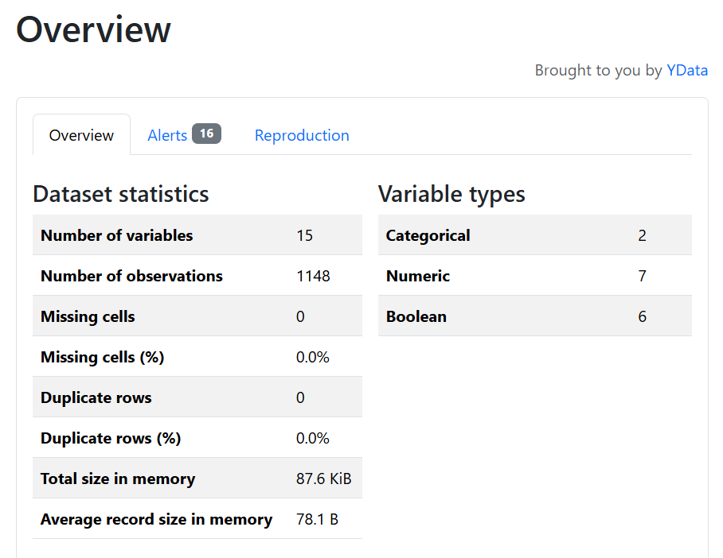
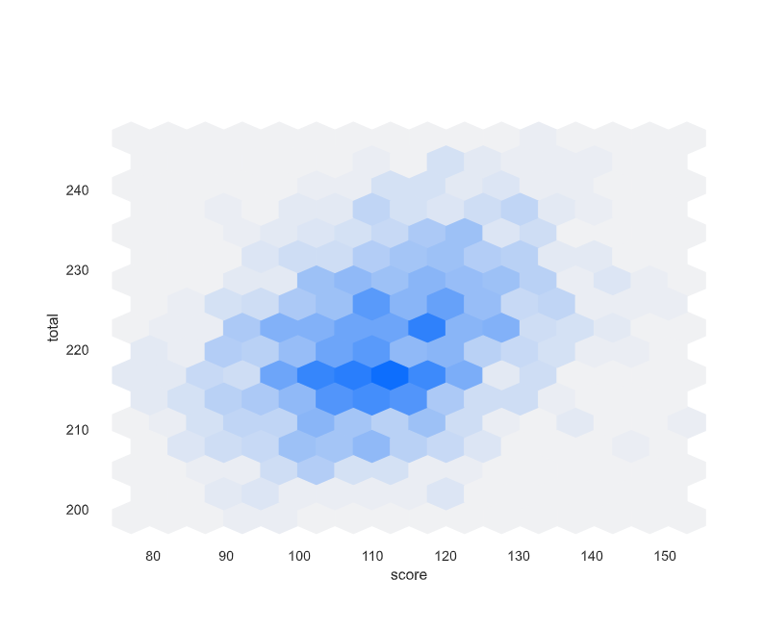
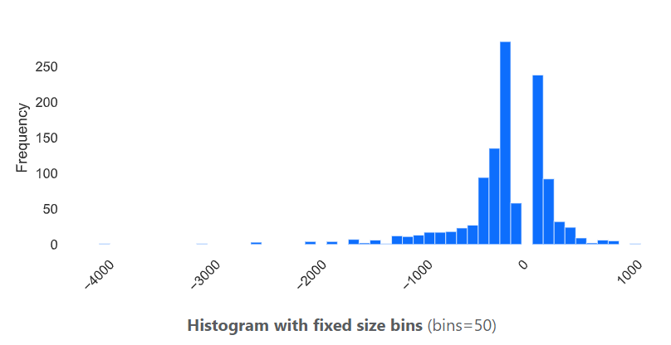
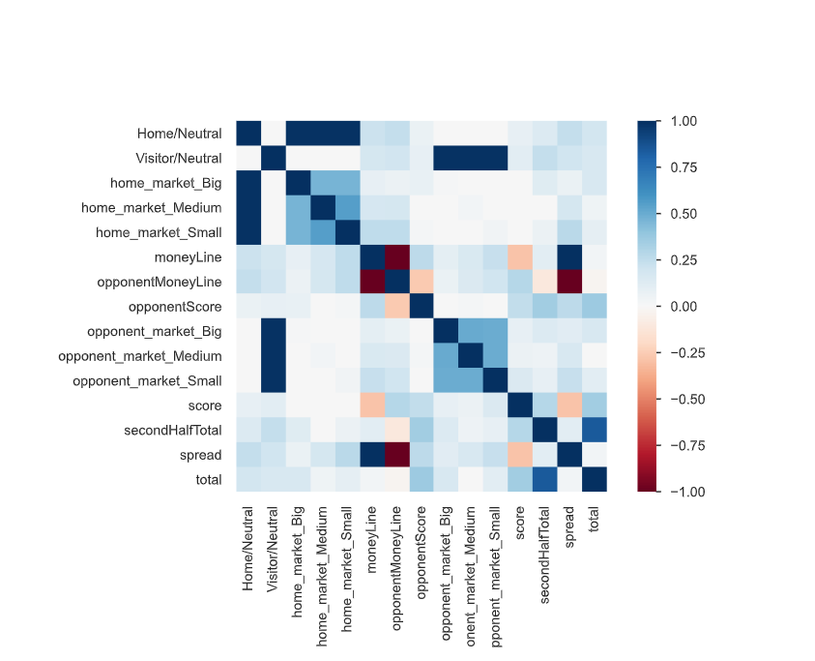
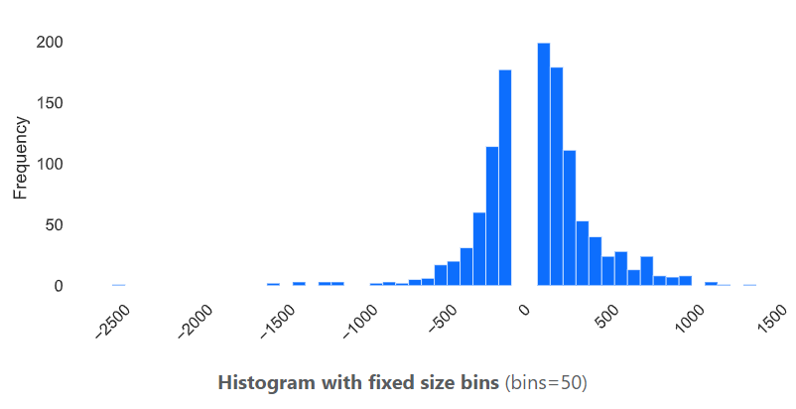
DATA 400: CAPSTONE IN DATA ANALYTICS
PHAM DUY ANH VU
EDA

Slide 11
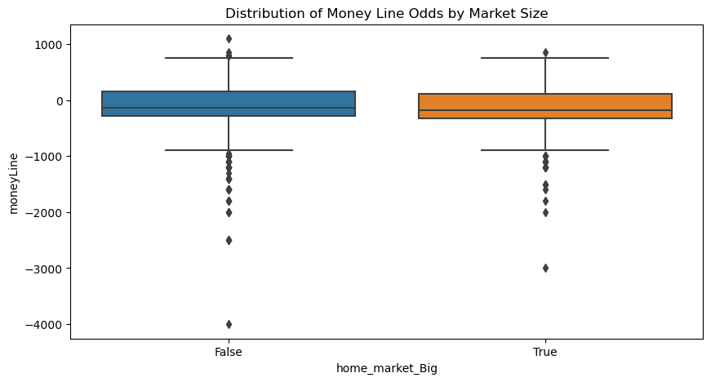
DATA 400: CAPSTONE IN DATA ANALYTICS
PHAM DUY ANH VU
REGRESSION ANALYSIS
Linear regression:
Mean absolute error: 83.2969
R2 score: 0.9072
ANOVA Test:
F-statistic: 36.3497
P-value: 4.948

Slide 12
THANK YOU!

Slide 13







































Resource Page
Use these design resources in your Canva Presentation.
FONTS
DESIGN ELEMENTS
This presentation template
uses the following free fonts:
INTER
You can find these fonts online too.
COLORS
#253278
#F8EFE5
DON'T FORGET TO DELETE THIS PAGE BEFORE PRESENTING.

